Slide 1

AI-Powered Cheating Detection System
Ensuring academic integrity in online examinations is critical. Our AI-powered system provides a robust solution. It detects and prevents cheating behaviors in real-time. This ensures fair and reliable assessments for all students. Continuous improvement and innovation are our priorities.
By: Sarthak Sharma , Anuj Chaudhary, Aryan Srivastava, Agrim Raj, Arihant Jain

Slide 2

Our Mission: Upholding Exam Integrity
Our main goal is real-time cheating detection and prevention.
Accurate Identification
Minimize False Positives
Identify cheating behaviors with high precision.
Reduce incorrect flags to ensure fairness.
Scalable Solution
User-Friendly Interface
Adapt to various online exam platforms.
Provide an intuitive interface for administrators.

Slide 3
System Architecture: Layers of Defense
Video & Audio Surveillance
AI-Driven Analysis
Real-Time Data Processing
Platform Integration
Behavioral analysis for suspicious activities.
Seamless integration with LMS platforms.
Continuous monitoring of the student.
Cloud storage for data analysis.

Slide 4

AI Techniques: The Core Engine
Computer Vision
Natural Language Processing
Gaze tracking and object detection.
Text analysis for copy/paste detection.
Machine Learning
Algorithms trained on cheating datasets.
Achieve 95% accuracy in staged scenarios. Reduce manual review time by 90%.

Slide 5

Detection Process: How It Works
Continuous Monitoring
Student behavior is constantly observed.
Real-Time Analysis
Video, audio, and text inputs are analyzed.
Anomaly Detection
AI algorithms identify suspicious activities.
Flagging
Suspicious activities are flagged for review.

Slide 6





Real-time Prevention: Taking Action
Instant Alerts
Proctors receive immediate notifications.
Automated Warnings
Students receive automated warnings.
Exam Suspension
Confirmed cheating leads to suspension.
Secure Browser
External access is blocked.

Slide 7
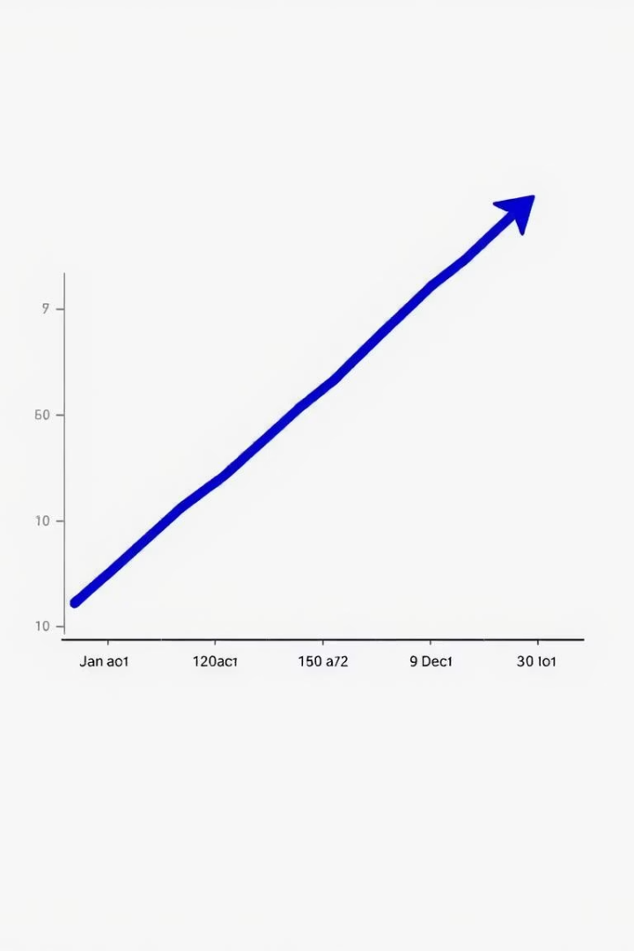
Results and Impact: Proof of Success
75%
Reduction in Cheating
Cheating incidents reduced in pilot program.
Improved student performance and fairness. Positive feedback from educators.

Slide 8





Future Plans: Expanding the Horizon
Enhanced AI
Advanced cheating detection algorithms.
Biometric Authentication
Integration with biometric methods.
Platform Expansion
Expansion to new platforms.
Global Partnerships
Partnerships with institutions globally.

Slide 9

Conclusion: The Future of Exam Integrity
Our AI-powered system is essential for fair and reliable assessments. We are committed to continuous improvement and innovation. Together, we can ensure academic integrity for all. Our system ensures accurate results.

